Slide 1

Projecting Monthly Rainfall Totals for North Carolina for the Next 50 Years
William Fetzner
Mentor:
Koray Kayir

Slide 2
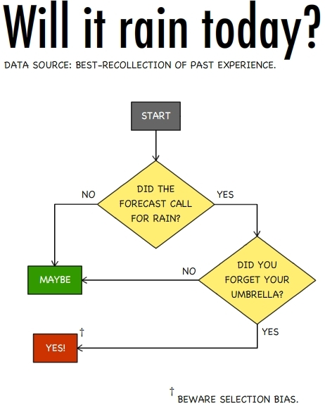
Introduction: Question
Is the average amount of rain changing?
Will it change over the next 50 years?

Slide 3
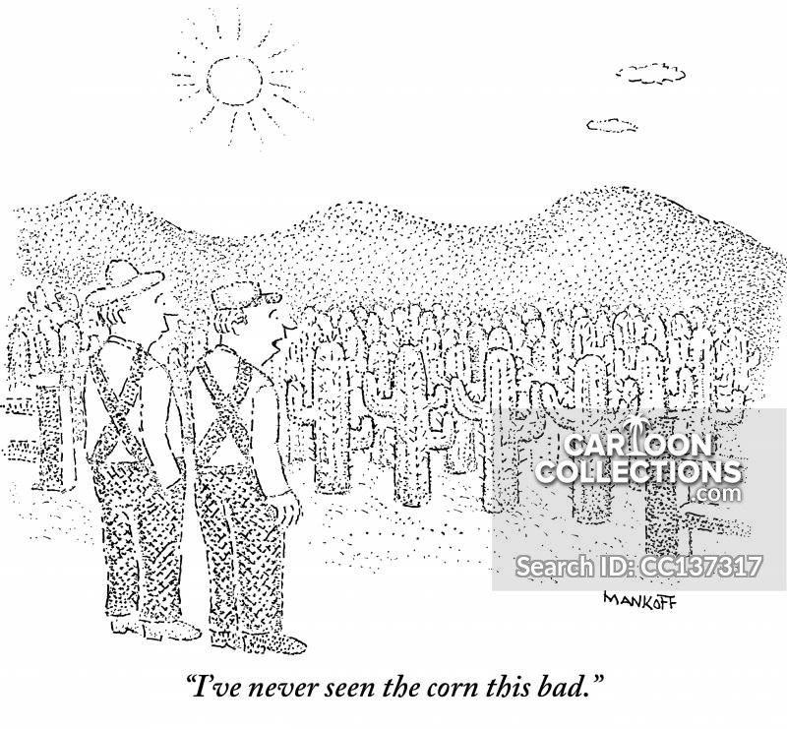
Why is this important?
Agricultural industry
What crops to grow during a season
Whether to switch to a different crop
Governmental planning
Building an additional reservoir
Implementing water restrictions

Slide 4

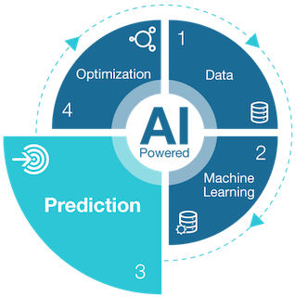
Goal
To predict rainfall amounts for North Carolina for the next 50 years

Slide 5
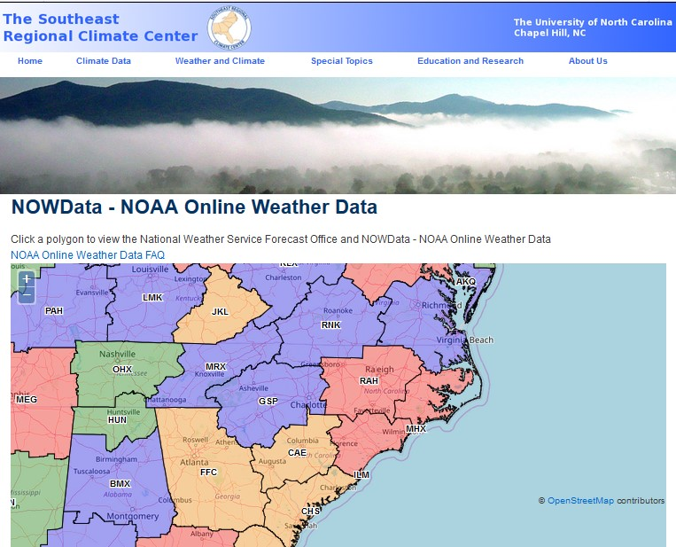
Data Source
Gathered from NOWData NOAA website
The circled area on the map is where the data was collected from
112 NC locations and 124 locations from SC, GA, TN, and VA

Slide 6
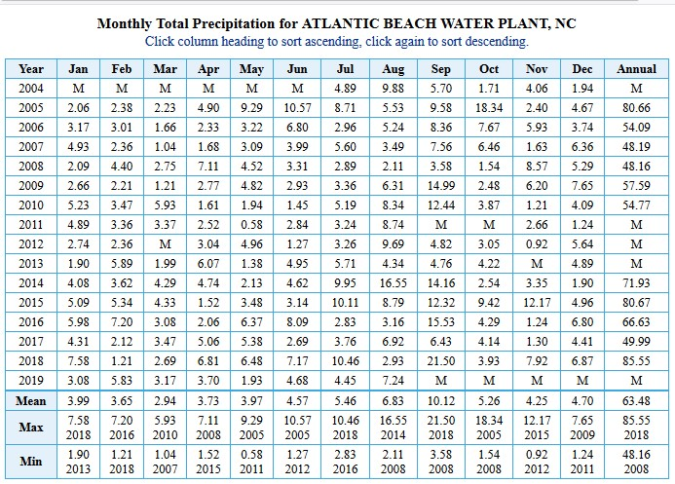
Data Cleaning
Poor original format for analysis

Slide 7
Data Cleaning
Own column for months
Poor original format for analysis
Removal of totals

Slide 8
Data Cleaning
Poor original format for analysis
Removal of totals
MISSING DATA!!!

Slide 9
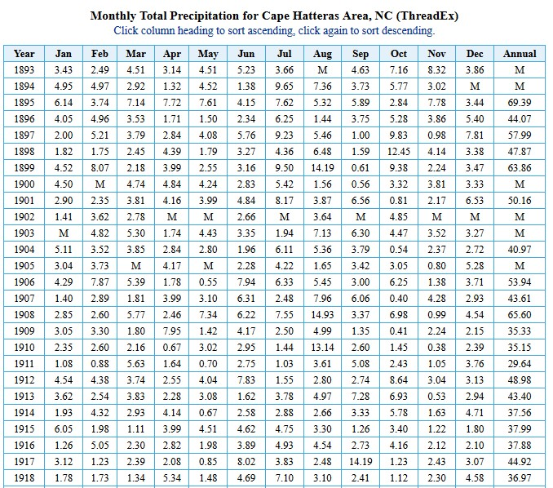
Data Cleaning
Poor original format for analysis
Removal of totals
MISSING DATA!!!
Dates are way off

Slide 10
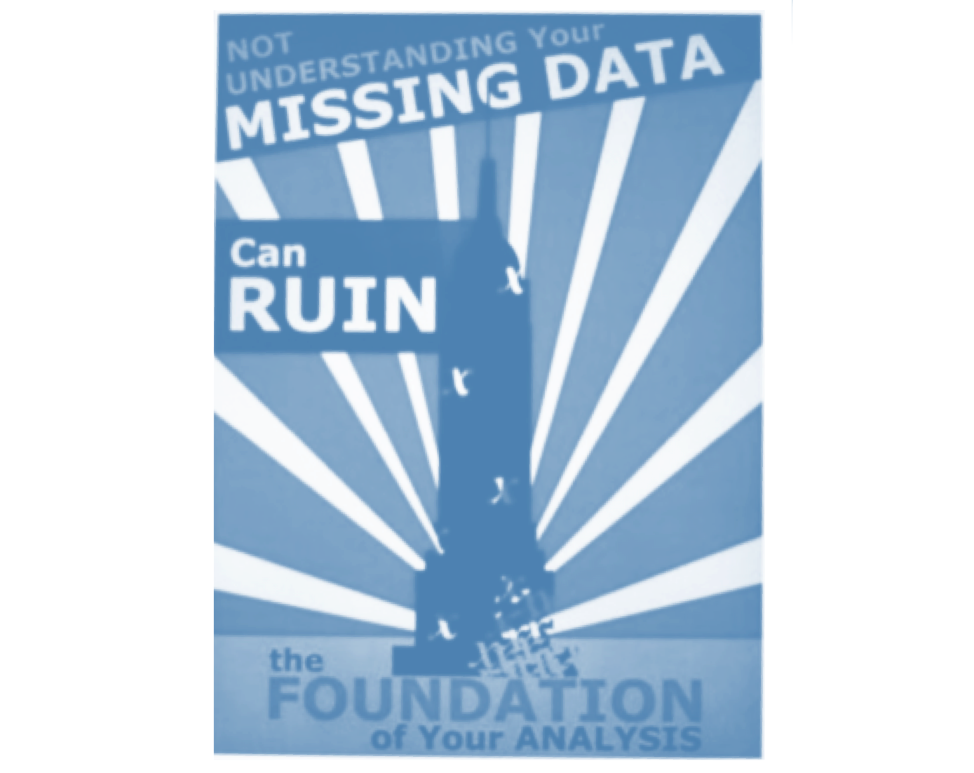
Data Cleaning
3 ways of dealing with missing data
Only included data from 1980-2019 (80% of locations had full data)
Estimation of missing values
Utilized the rainfall total from the previous month, the next month and the corresponding month of the previous year and averaged them
Averaged the rainfall for the target month of all locations within 85 kilometers (~ 50 miles)

Slide 11
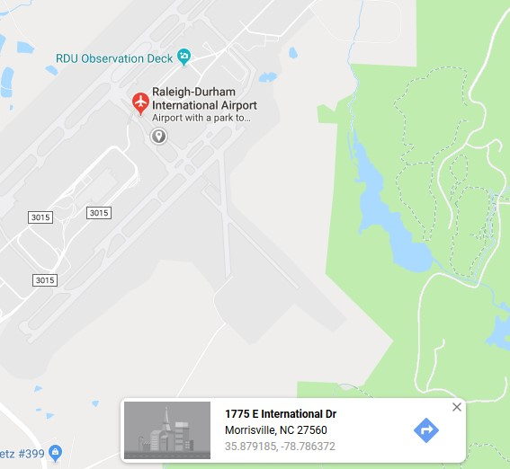
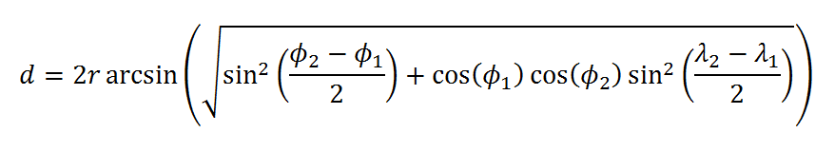
Where’d the distance come from?
Latitude and Longitude of each location
Haversine Formula

Slide 12
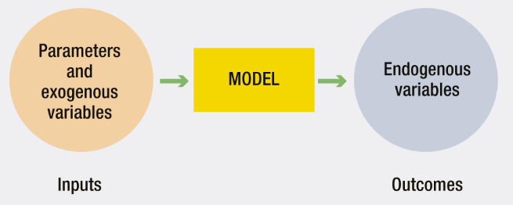
External location pairing
46 target locations
External locations within 50 kilometers
Target and corresponding external placed into dictionary

Slide 13
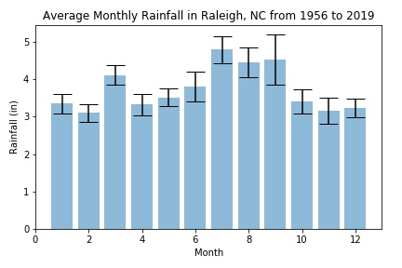
Exploratory Data Analysis
What does it look like?

Slide 14
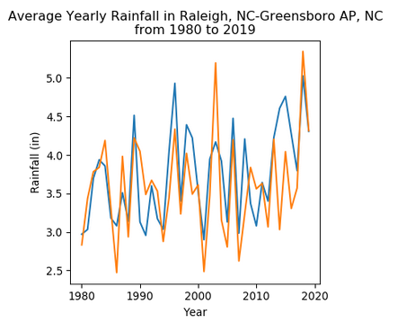
Exploratory Data Analysis
What does it look like?

Slide 15
Exploratory Data Analysis
What does it look like?

Slide 16
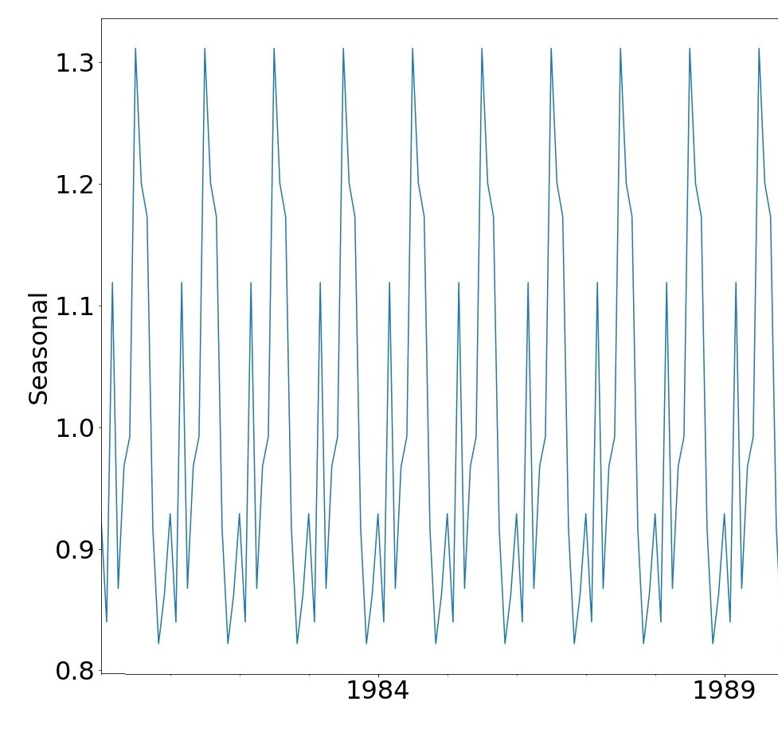
Seasonal Decomposition
Periodicity was 12 months

Slide 17
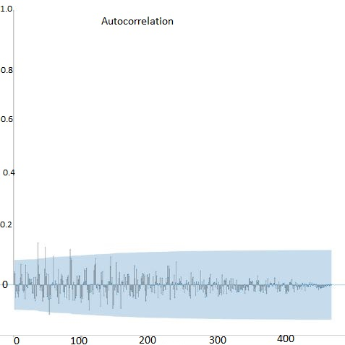
Autocorrelation
Correlation of the location with itself

Slide 18
Autocorrelation
Date | Raleigh, NC | lag 1 | lag 12
1/1/1980 | 4.39 | 1.91 | 0.87
2/1/1980 | 1.91 | 5.87 | 3.02
3/1/1980 | 5.87 | 1.97 | 2.35
4/1/1980 | 1.97 | 2.33 | 1.03
5/1/1980 | 2.33 | 4.89 | 4.28
6/1/1980 | 4.89 | 2.11 | 0.55
7/1/1980 | 2.11 | 1.87 | 5.69
8/1/1980 | 1.87 | 3.76 | 5.34
9/1/1980 | 3.76 | 2.25 | 2.7
10/1/1980 | 2.25 | 2.87 | 4.64
11/1/1980 | 2.87 | 1.42 | 0.95
12/1/1980 | 1.42 | 0.87 | 4.96
1/1/1981 | 0.87 | 3.02 | 3.43
2/1/1981 | 3.02 | 2.35 | 4.97
3/1/1981 | 2.35 | 1.03 | 3.02
4/1/1981 | 1.03 | 4.28 | 3.33
5/1/1981 | 4.28 | 0.55 | 4.2
6/1/1981 | 0.55 | 5.69 | 8.39
7/1/1981 | 5.69 | 5.34 | 3.34
8/1/1981 | 5.34 | 2.7 | 1.83
9/1/1981 | 2.7 | 4.64 | 1.55
10/1/1981 | 4.64 | 0.95 | 3.93
Lag 1 & lag 12

Slide 19
Machine Learning
Seasonal Autoregressive Integrated Moving Average
SARIMA (p,d,q)(P,D,Q,m)
p = order or number of time lags of the autoregressive model
d = degree of differencing (number of times the data has had past values subtracted)
q = order of the moving-average model
P, D, Q = similar just for seasonal part of model
m = periodicity of the data

Slide 20
Hyperparameters of SARIMA
D, d and m were determined from the dataset
Trend = 0 thus, D and d = 0
m = 12, period shown in seasonal decomposition and autocorrelation
P, Q, p, and q were tuned
Training (80%), Validation (10%), Testing (10%)
Mean absolute error
Determined performance of model
RESULT: p = 4, d = 0, q=3, P=3, D=0, Q=4, m=12

Slide 21

Exogenous help?
46 locations with external locations
8 of the 46 with a better model when using exogenous variables
Whiteville, NC
Casar, NC
Forest City, NC
Gastonia, NC
Lake Lure, NC
Elizabethtown, NC
Mount Holly, NC
Grandfather Mtn, NC

Slide 22
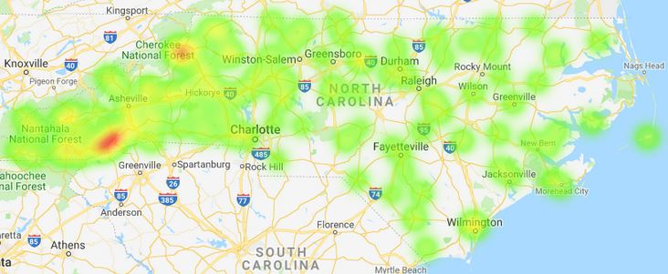
Predictions

Slide 23
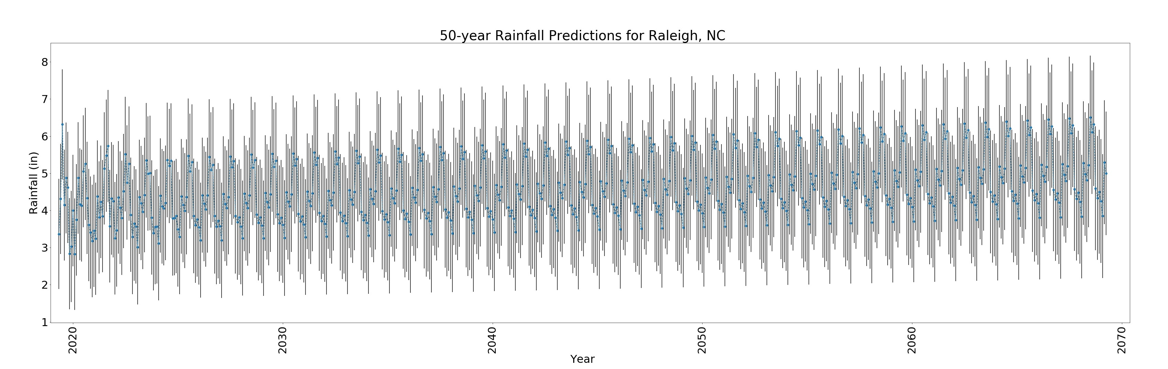
Conclusions
Not a significant change, but rainfall is predicted to increase over next 50 years
Implement higher regulations for protections against flooding in developing areas

Slide 24
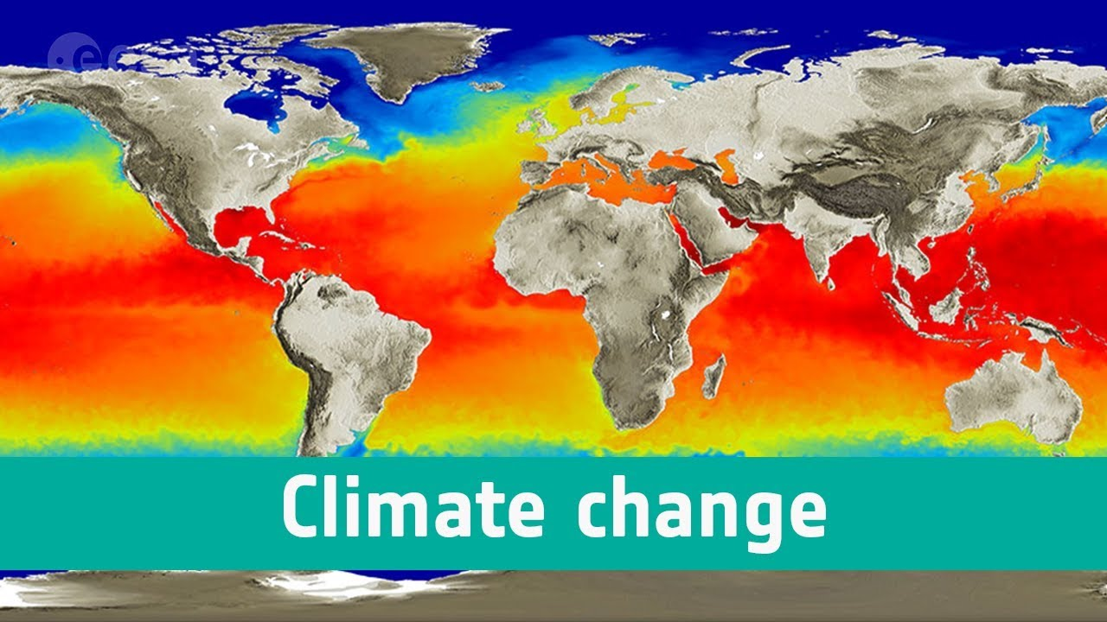
Future Research
Include other influential variables
Climate change predictions
Historic climate data based upon cores and other areas of research besides just historic records
Larger more complete dataset

